Slide 1
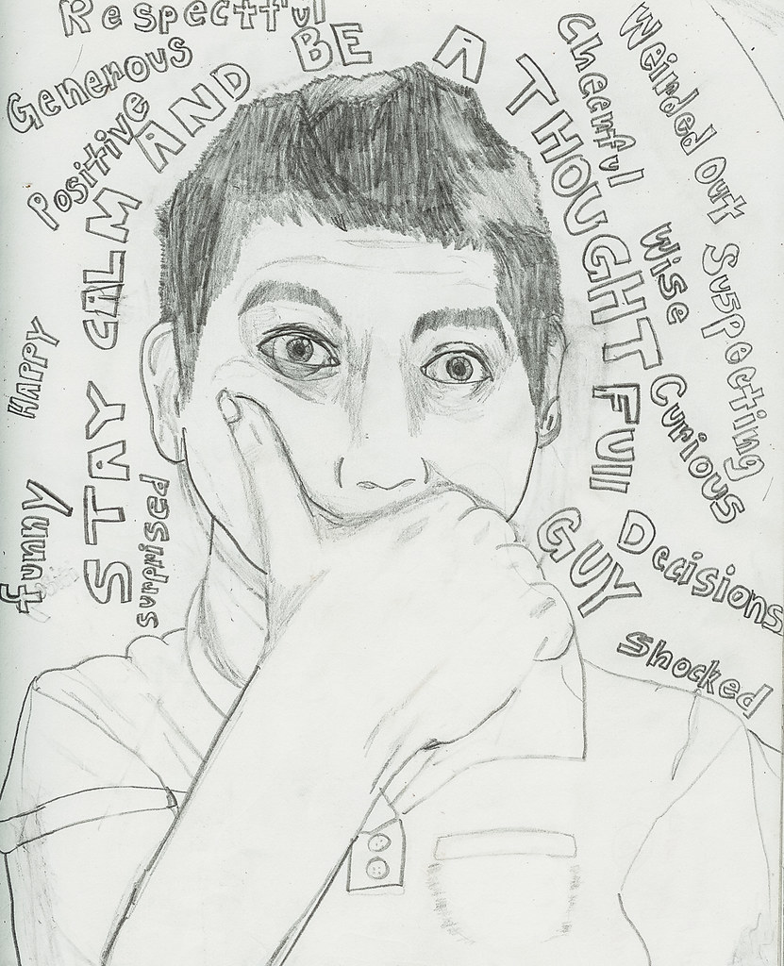
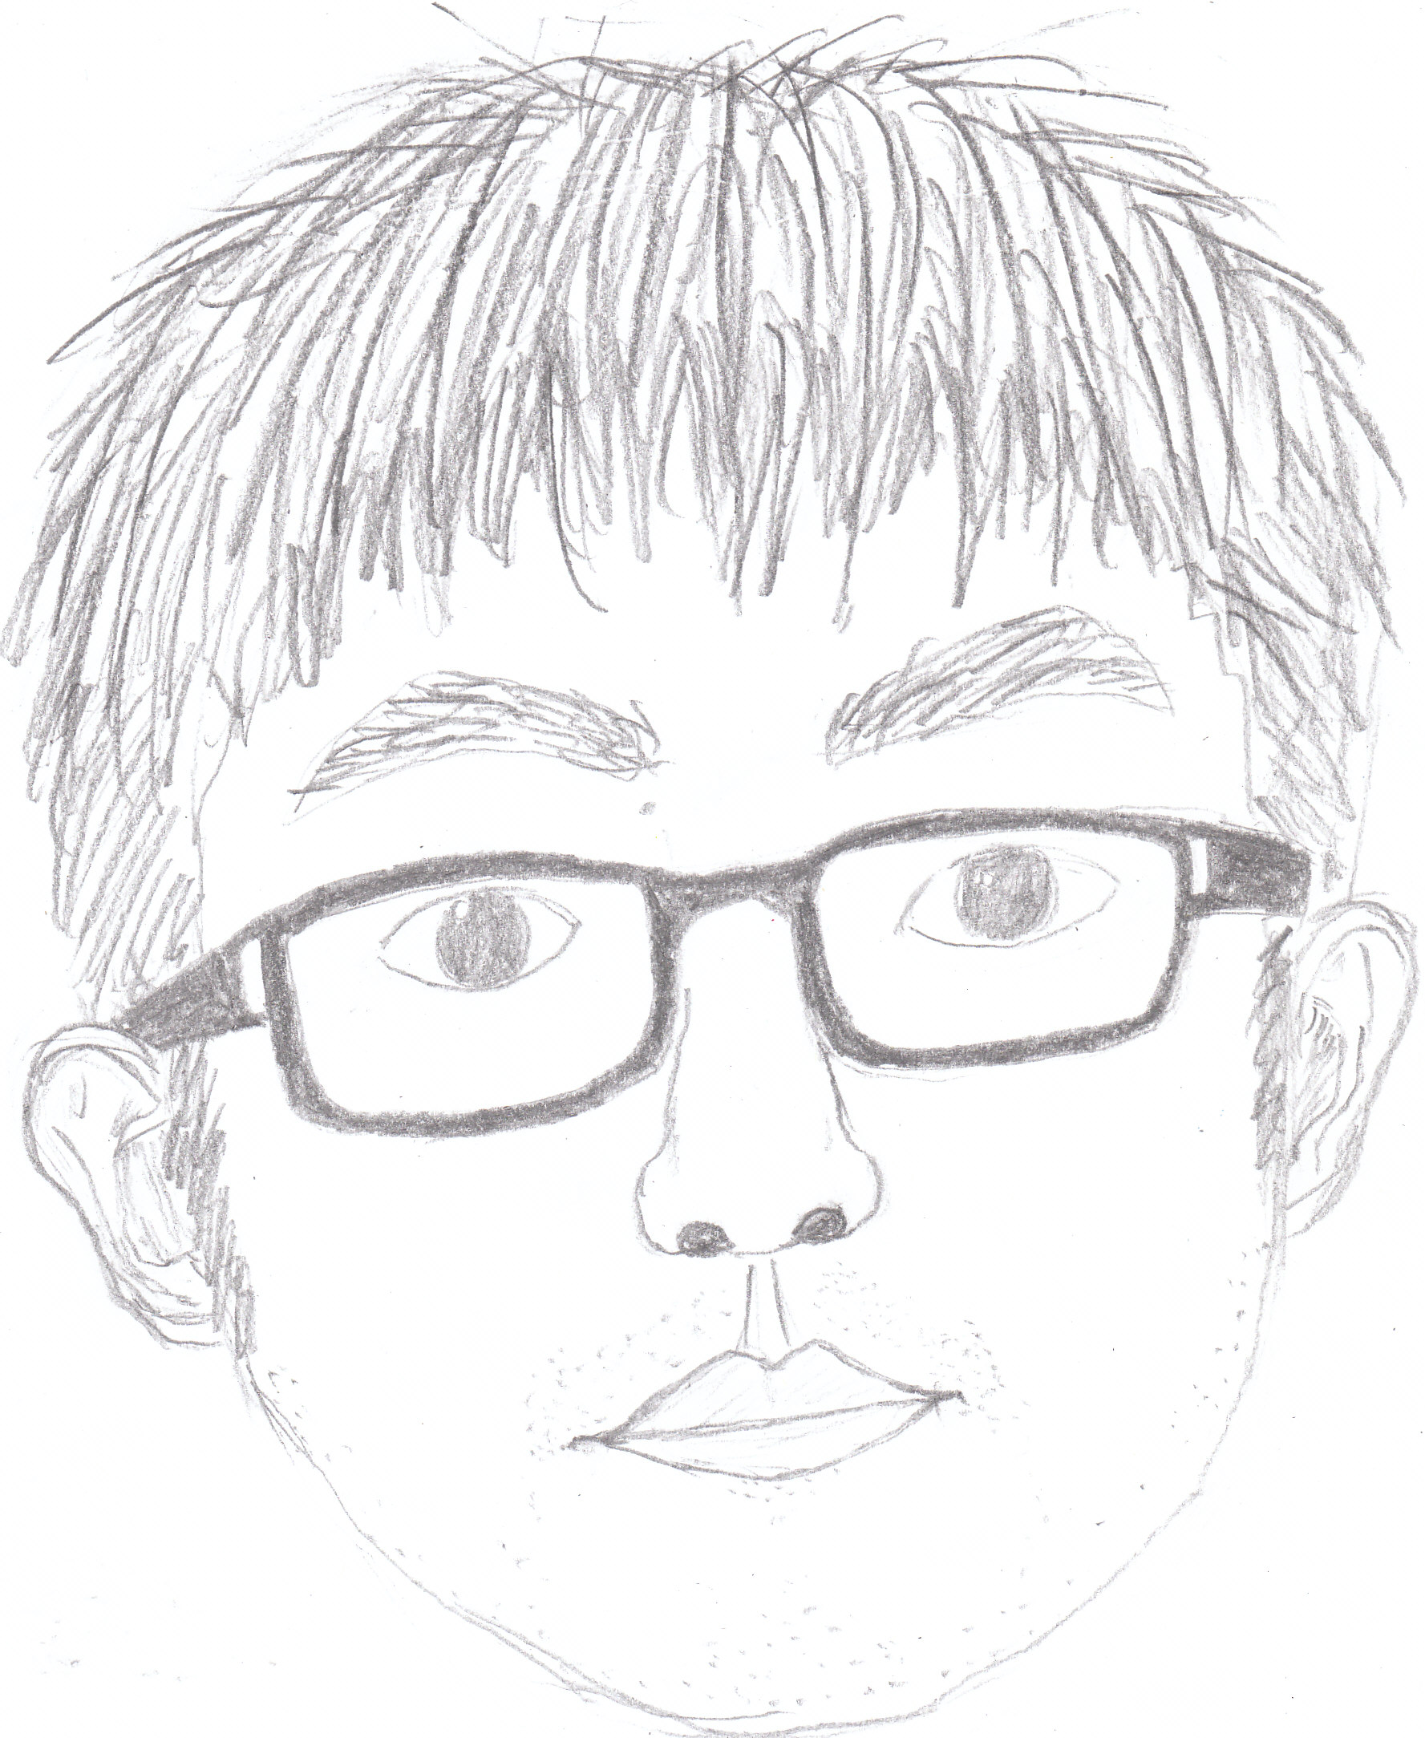
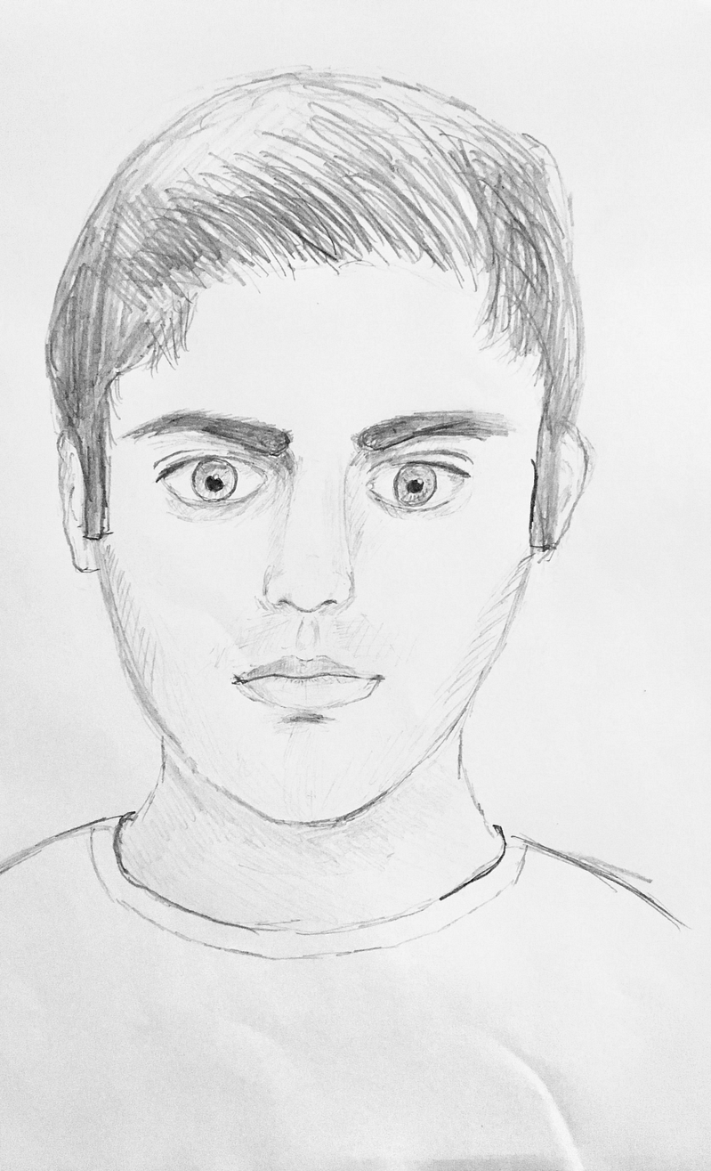
Welcome to UHS Art!
Using whatever pencils/ pens/ colour you have at access to at home, create a self-portrait.
Around the background, write a minimum of 5 GOLD (positive) traits about yourself.

Slide 6
History Challenge
Why did William build castles in England?
Imagine you are the new King of England and you have decided to build a castle for your soldiers.
Think about the following things:

Slide 7
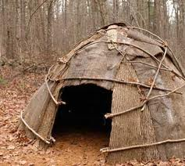
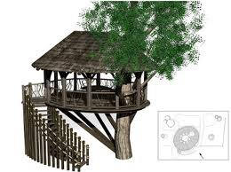
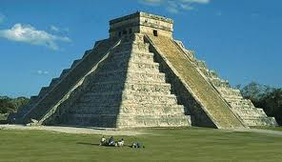
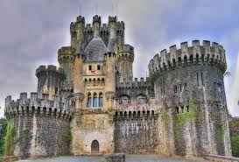
How would you keep your men safe?
Mud Hut
Tree House
Castle
Stone Temple

Slide 8
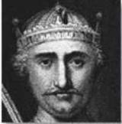
Where would you build your castle, and why?
D
OPEN COUNTRY
MARSH
C
A
HILL TOP
B
Where you would build your castle.
WOODED AREA

Slide 9
‘What features would you expect a castle to have?’

Slide 10
the keep
palisade
stairs
the motte
huts
the bailey
drawbridge
deep ditch
entrance
Task: to create a diagram or a 3D model of the castle you, King William, have created for your soldiers to keep them safe

Slide 11
Welcome to UHS Languages
Your task:
Research a French or Spanish speaking country and create a poster to summarise your findings. Some ideas:
create a recipe card in the target language (Spanish or French)
research a French or Spanish celebrity
Draw the French or Spanish football teams
Your poster should consist on one page of A4.
Don’t forget to include pictures!

Slide 14
Welcome to UHS Science

Slide 15
The Scientific Method
Watch the video using the link, then write down the steps below. https://www.youtube.com/watch?v=yi0hwFDQTSQ
1.
2.
3.
4.
5.
6.
Now follow the instructions on the pages below and complete the tasks.

Slide 19
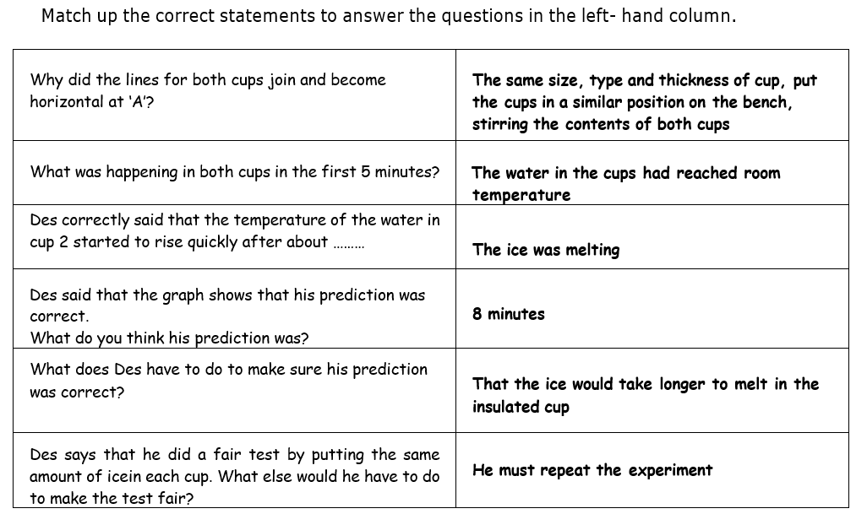

Slide 20
